Slide 1

SLIDE TITLE

Slide 3
SLIDE TITLE

Slide 4
HEADTITLE – small addition

Slide 5
MARC MUSTERMANN conference chair

Slide 6
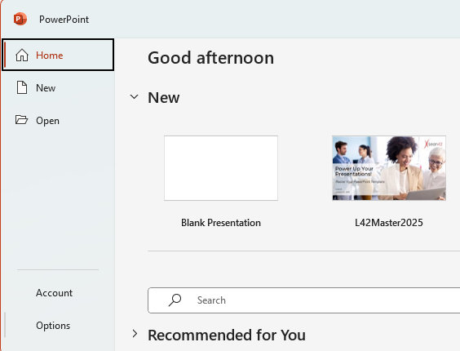
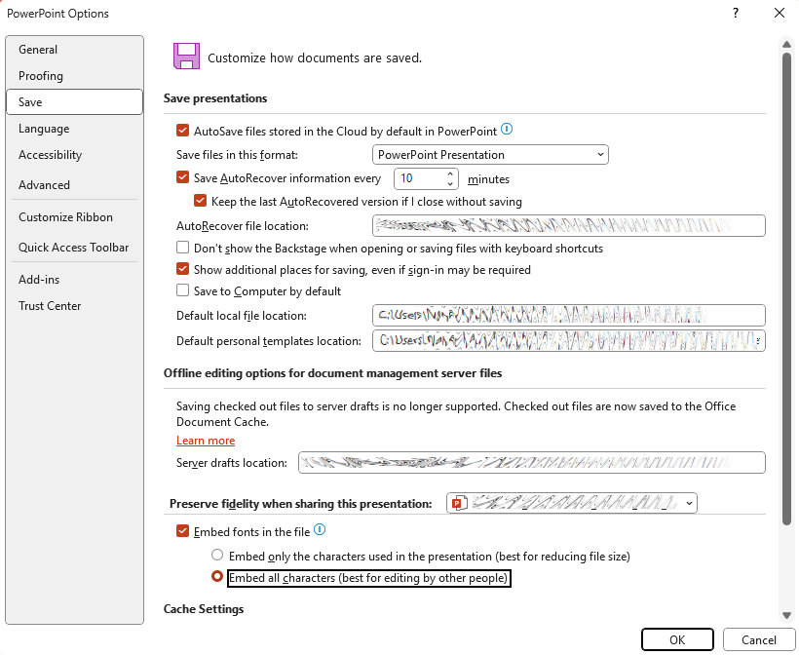
HOW TO EMBED FONTS in PowerPoint
Please make sure to fully embed the fonts in PowerPoint!
Open your PowerPoint file.
Go to File → Options.
In the PowerPoint Options window, select Save.
Check Embed fonts in the file.
  "Embed only the characters used" for smaller file size.
  Choose "Embed all characters" for full editing compatibility → we prefer this option so that all characters are available in the event of any changes.
✅ Now your fonts will travel with your presentation!
2
1
3
4
5

Slide 7

THANK YOU

